Slide 1
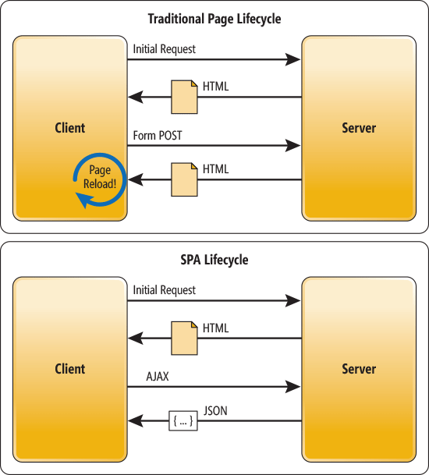
AngularJs + ASP.NET MVC
Hybrid SPA (Single Page Application)

